Slide 1

Simple Linear Regression
Presented by:
Elizer Ponio Jr.
Department of Computer Science
College of Computing and Information Technologies

Slide 2
Outline
Classification vs Regression
What is Linear Regression?
Types of Linear Regression
Understanding Simple Linear Regression

Slide 3
Classification vs Regression
Supervised Learning
Classification
Regression
Simple Linear
Regression
Multiple Linear
Regression
Polynomial Linear
Regression

Slide 4

Classification vs Regression

Slide 5
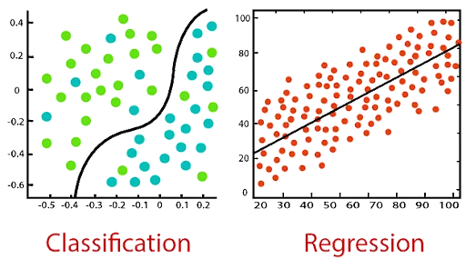
Classification vs Regression
Classification | Regression
The output variable must be a discrete value in the form of a class label. | The output variable must be either continuous in nature or a real value in the form of an integer quantity.
Classification algorithms solve classification problems like identifying spam e-mails, and spotting cancer cells . | It is used to solve problems such as predicting house prices and weather predictions.
Classification tries to find the decision boundary, which divides the dataset into different classes. | It attempts to find the best fit line, which predicts the output more accurately.

Slide 6
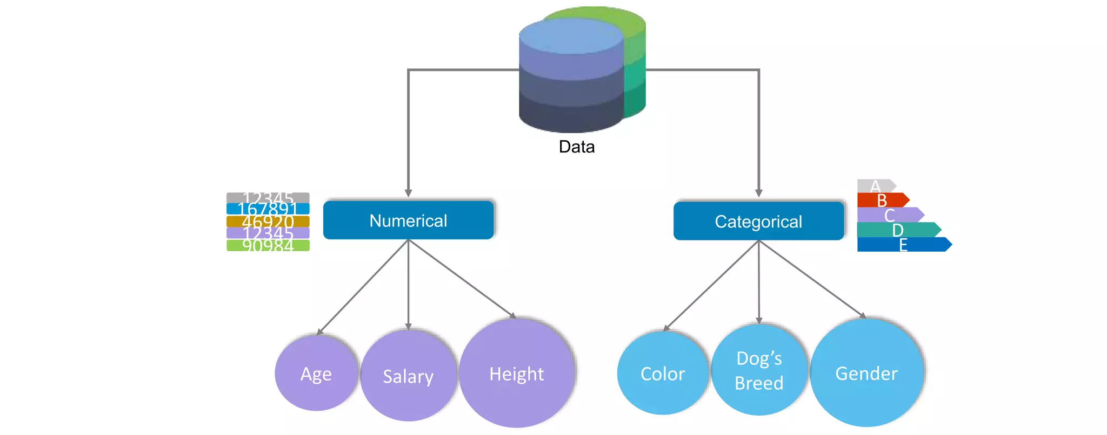
Numerical and Categorical Values

Slide 7

Classification vs Regression
What is Linear Regression?
Types of Linear Regression
Understanding Simple Linear Regression

Slide 8

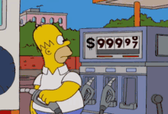

What is Linear Regression?
Current Jeepney Fare
Price of Fuel
Predicted Jeepney Fare
Based on the price of fuel, how much would be the jeepney fare?

Slide 9
What is Linear Regression?
Linear regression or simply regression is a statistical model used to predict the relationship between independent and dependent variables.

Slide 10
Independent and Dependent Variables
Independent Variable | Dependent Variable
A variable whose value does not change by the effect of other variables and is used to manipulate the dependent variable. Often denoted as X | A variable whose value changes when there is a manipulation in the values of the independent variables. Often denoted as Y
Price of
Fuel
Jeepney Fare

Slide 11
What is Linear Regression
In Linear Regression, we examine two factors.
1. Which variables are significant predictors of the outcome variable?
2. How significant is the regression line in terms of making predictions with the highest possible accuracy?

Slide 12
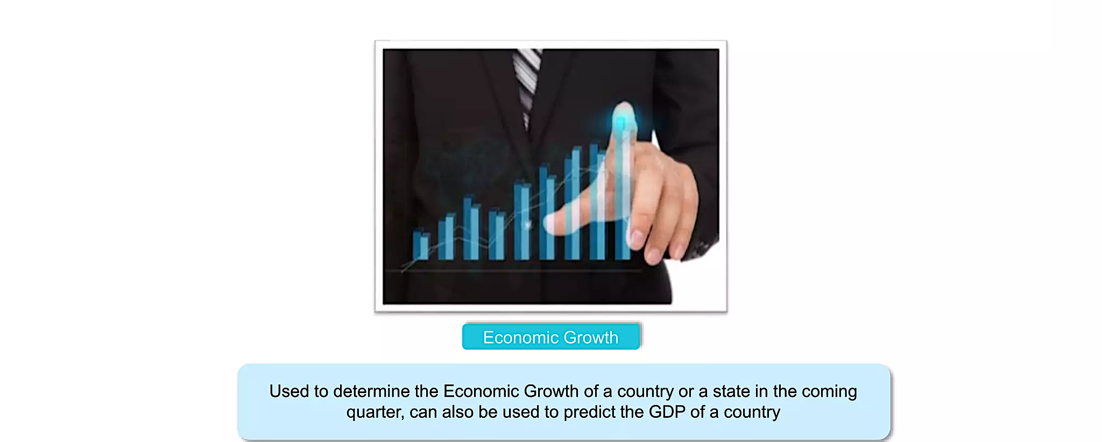
Applications of Linear Regression

Slide 13
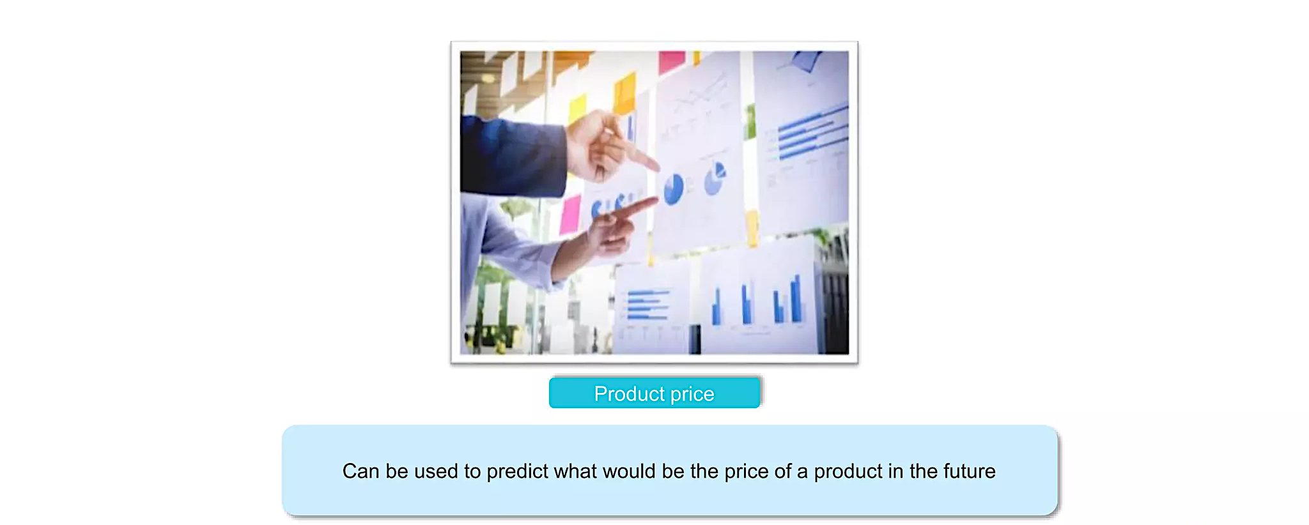
Applications of Linear Regression

Slide 14
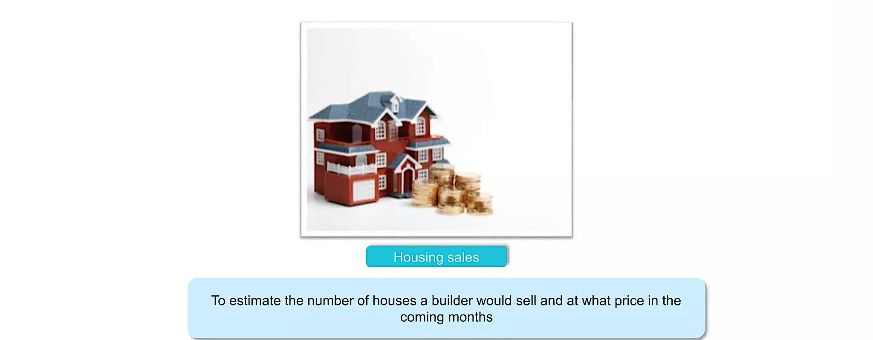
Applications of Linear Regression

Slide 15
Classification vs Regression
What is Linear Regression?
Types of Linear Regression
Understanding Simple Linear Regression

Slide 16
Types of Linear Regression
Simple Linear Regression | Multiple Linear Regression
This type involves estimating the relationship between two variables, the dependent variable and independent variable. | In this type, you can determine the relationship between several independent variables and a dependent variable.

Slide 17


Simple Linear Regression
Crop Yield Prediction
Independent Variable
Dependent Variable
Rainfall
Crop yield/Amount of crop grown

Slide 18


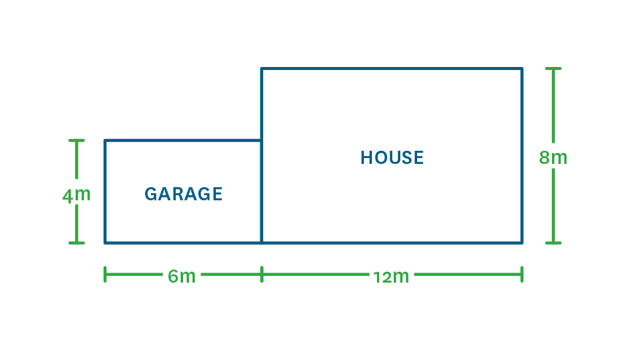
Multiple Linear Regression
Independent Variables for House Price Prediction
Location
Number of Bedrooms
Area

Slide 19
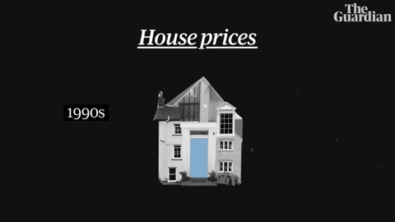
Multiple Linear Regression
Dependent Variable for House Price Prediction
Price

Slide 20
Classification vs Regression
What is Linear Regression?
Types of Linear Regression
Understanding Simple Linear Regression

Slide 21
The Regression Line
Jeepney Fare (Y)
Price of Fuel (X)

Slide 22
The Regression Line
The regression line can be used to predict the value of y given a value of x.
It also tells you:
How much and in what direction the dependent variable (y) changes when the independent variable (x) changes.
The general trend or relationship between the dependent (y) and independent variables (x)

Slide 23
Prediction using the Regression Line
Jeepney Fare (Y)
Price of Fuel (X)

Slide 24
Intuition Behind the Regression Line
Let us consider a sample dataset with 5 rows and find out how to draw the regression line.
Price of Fuel (X) | Jeepney Fare (Y)
1 | 2
2 | 4
3 | 5
4 | 4
5 | 5

Slide 25
Intuition Behind the Regression Line
Jeepney Fare (Y)
Price of Fuel (X)
Notes:
Have you asked yourself the question, why do people organize?
Lets go to the psychology of organizing
This predictability applies within the context of our homes, manifesting through the concept of organization

Slide 26
Intuition Behind the Regression Line
Price of Fuel (X) | Jeepney Fare (Y)
1 | 2
2 | 4
3 | 5
4 | 4
5 | 5
Jeepney Fare (Y)
Price of Fuel (X)
Notes:
Have you asked yourself the question, why do people organize?
Lets go to the psychology of organizing
This predictability applies within the context of our homes, manifesting through the concept of organization

Slide 27
Intuition Behind the Regression Line
Price of Fuel (X) | Jeepney Fare (Y) | (X * Y) | X²
1 | 2 | 2 | 1
2 | 4 | 8 | 4
3 | 5 | 15 | 9
4 | 4 | 16 | 16
5 | 5 | 25 | 25
Σx = 15
Σy = 20
Σxy = 66
Σx² = 55
Step 1: Get the sum of X, Y, (X * Y) and X²
Notes:
Have you asked yourself the question, why do people organize?
Lets go to the psychology of organizing
This predictability applies within the context of our homes, manifesting through the concept of organization

Slide 28
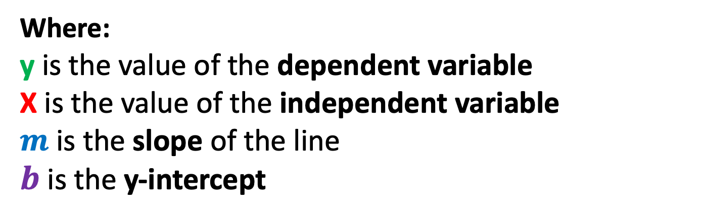
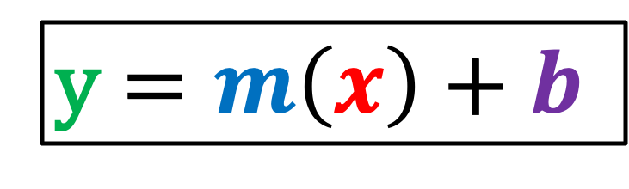
Regression Equation
The simplest form of a simple linear regression equation with one dependent and one independent variable is represented by:
y $=m\left(x\right)+b$
Where:
y is the value of the dependent variable
X is the value of the independent variable
$m$ is the slope of the line
$b$ is the y-intercept
Notes:
Have you asked yourself the question, why do people organize?
Lets go to the psychology of organizing
This predictability applies within the context of our homes, manifesting through the concept of organization

Slide 29
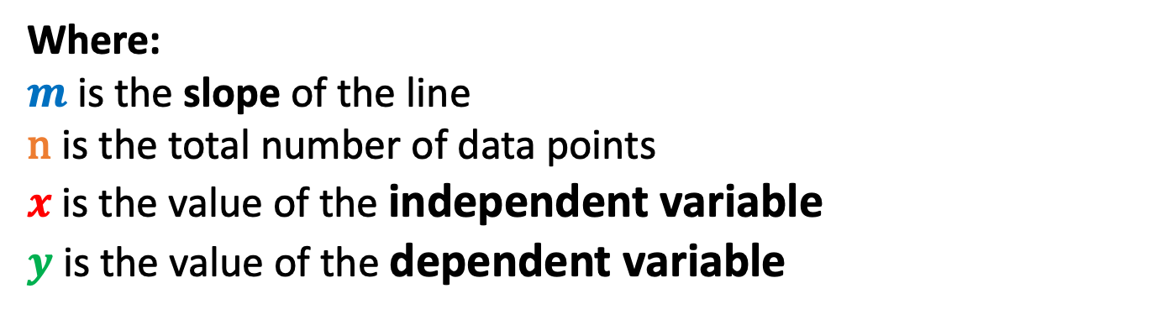
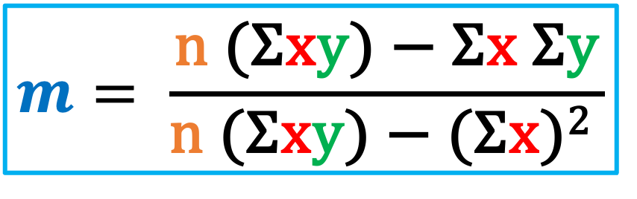
Regression Equation
Calculating the slope is given by this formula:
$$m= \frac{\text{n} \text{(}\text{Σ}\text{x}\text{y}\text{)}\text{ − }\text{Σ}\text{x} \text{Σ}\text{y}}{\text{n} \text{(}\text{Σ}\text{x}\text{y}\text{)}\text{ − }\text{(}\text{Σ}\text{x}\text{)}\text{2} }$$
Where:
$m$ is the slope of the line
$\text{n}$is the total number of data points
$x$ is the value of the independent variable
$y$ is the value of the dependent variable
Notes:
Have you asked yourself the question, why do people organize?
Lets go to the psychology of organizing
This predictability applies within the context of our homes, manifesting through the concept of organization

Slide 30
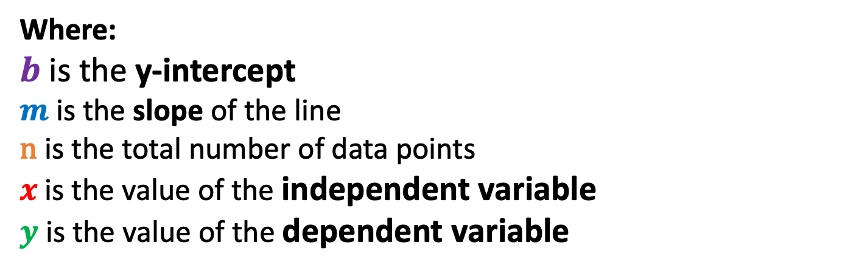
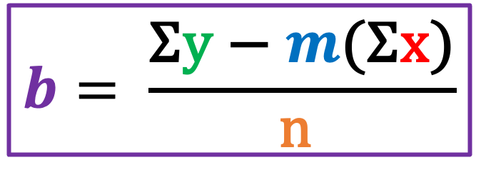
Regression Equation
Calculating the intercept is given by this formula:
$$b= \frac{\text{Σ}\text{y}\text{ −} m\text{(}\text{Σ}\text{x}\text{)}}{\text{n} }$$
Where:
$b$ is the y-intercept
$m$ is the slope of the line
$\text{n}$is the total number of data points
$x$ is the value of the independent variable
$y$ is the value of the dependent variable
Notes:
Have you asked yourself the question, why do people organize?
Lets go to the psychology of organizing
This predictability applies within the context of our homes, manifesting through the concept of organization

Slide 31
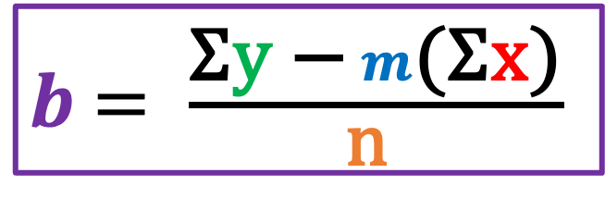
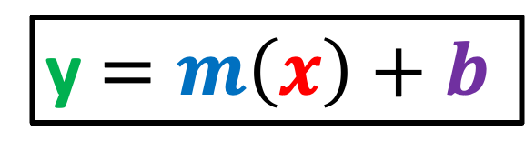
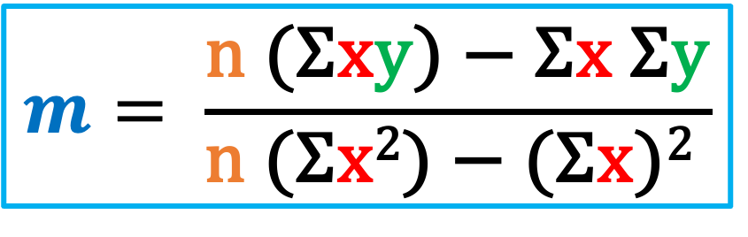
Regression Equation
Price of Fuel (X) | Jeepney Fare (Y)
1 | 1.5
2 | 3.8
3 | 6.7
4 | 9
5 | 11.2
6 | 13.6
7 | 16
y $=m\left(x\right)+b$
$$m= \frac{\text{n} \text{(}\text{Σ}\text{x}\text{y}\text{)}\text{ − }\text{Σ}\text{x} \text{Σ}\text{y}}{\text{n} \text{(}\text{Σ}\text{x}\text{2}\text{)}\text{ − }\text{(}\text{Σ}\text{x}\text{)}\text{2} }$$
$b$ $= \frac{\text{Σ}\text{y}\text{ −} m\text{(}\text{Σ}\text{x}\text{)}}{\text{n} }$
Notes:
Have you asked yourself the question, why do people organize?
Lets go to the psychology of organizing
This predictability applies within the context of our homes, manifesting through the concept of organization

Slide 32
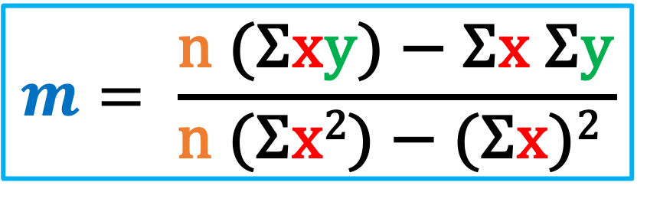
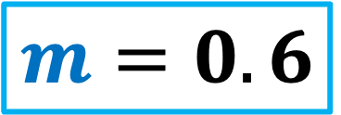
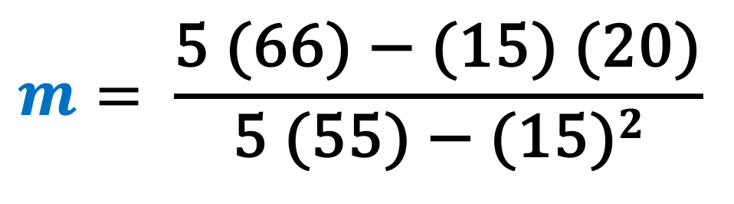
Calculate the Slope
Σx | Σy | Σxy | Σx²
15 | 20 | 66 | 55
$$m= \frac{\text{n} \text{(}\text{Σ}\text{x}\text{y}\text{)}\text{ − }\text{Σ}\text{x} \text{Σ}\text{y}}{\text{n} \text{(}\text{Σ}\text{x}\text{2}\text{)}\text{ − }\text{(}\text{Σ}\text{x}\text{)}\text{2} }$$
$$m= \frac{\text{5}\text{ (66)}\text{ − }\text{(15)} \text{(20)}}{\text{5} \text{(55)}\text{ − }\text{(15)}2}$$
$$m=0.6$$
Notes:
Have you asked yourself the question, why do people organize?
Lets go to the psychology of organizing
This predictability applies within the context of our homes, manifesting through the concept of organization

Slide 33

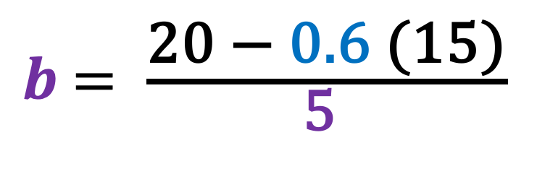
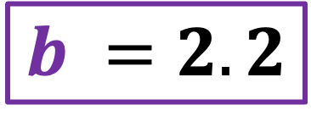
Calculate the Intercept
Σx | Σy | Σxy | Σx²
15 | 20 | 66 | 55
$b$ $= \frac{\text{Σ}\text{y}\text{ −} m\text{(}\text{Σ}\text{x}\text{)}}{\text{n} }$
$b$ $= \frac{\text{20}\text{ − }\text{0.6} \text{(15)}}{\text{5} }$
$$b =2.2$$

Slide 34
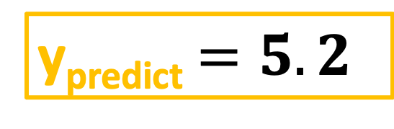
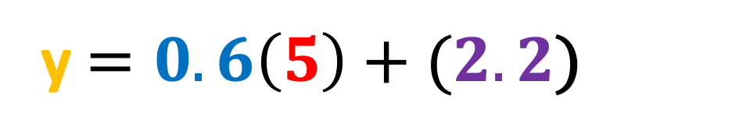
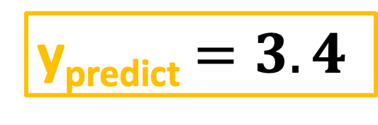
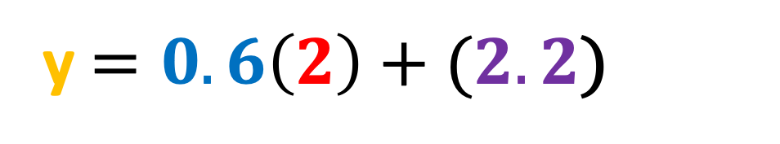
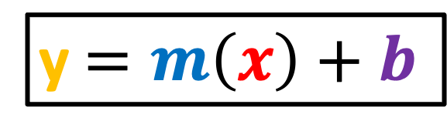
Predicting the Jeepney Fare
Price of Fuel (X) | Jeepney Fare (Y) | Predicted Jeepney Fare (Y_{predict})
1 | 2 | 2.8
2 | 4 | 3.4
3 | 5 | 4
4 | 4 | 4.6
5 | 5 | 5.2
y $=m\left(x\right)+b$
y $=0.6\left(2\right)+(2.2$)
y_{predict} $=3.4$
y $=0.6\left(5\right)+(2.2$)
m | b
0.6 | 2.2
y_{predict} $=5.2$

Slide 35
Drawing the Regression Line
Price of Fuel (X) | Jeepney Fare (Y) | Predicted Jeepney Fare (Y_{predict})
1 | 2 | 2.8
2 | 4 | 3.4
3 | 5 | 4
4 | 4 | 4.6
5 | 5 | 5.2
Jeepney Fare (Y)
Price of Fuel (X)

Slide 36
Drawing the Regression Line
The blue points represent the actual Y values and the orange points represent the predicted Y values
Jeepney Fare (Y)
Price of Fuel (X)

Slide 37
Residuals/Errors
The distance between the actual values and the predicted values are known as residuals or errors
Residual
Jeepney Fare (Y)
Price of Fuel (X)

Slide 38
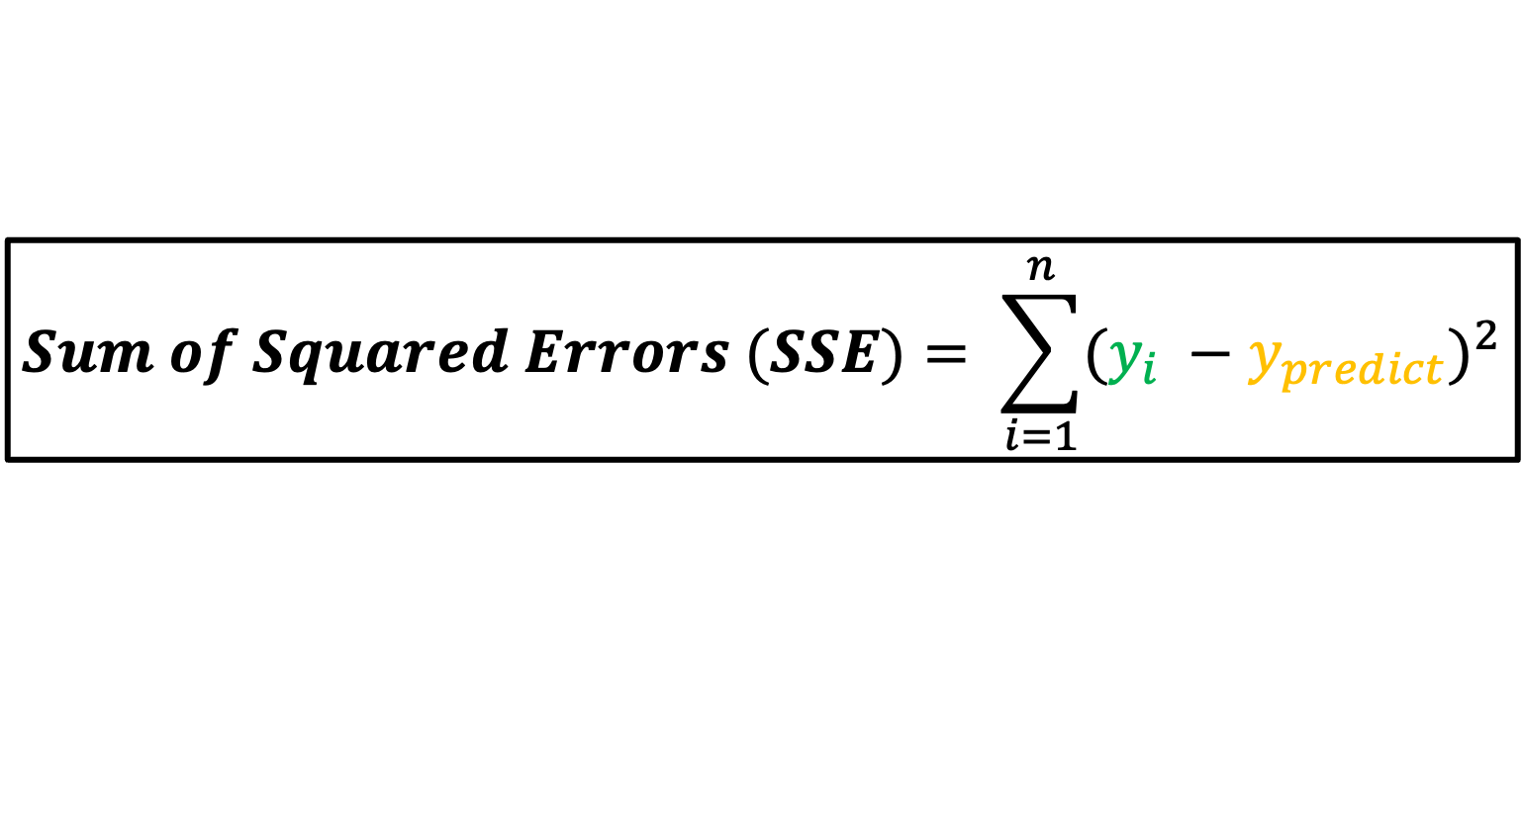
Error/Loss Function
Price of Fuel (X) | Jeepney Fare (Y) | Predicted Jeepney Fare (Y_{predict}) | Y - Y_{predict} | (Y – Y_{predict})²
1 | 2 | 2.8 | -0.8 | 0.64
2 | 4 | 3.4 | 0.6 | 0.36
3 | 5 | 4 | 1 | 1
4 | 4 | 4.6 | -0.6 | 0.36
5 | 5 | 5.2 | -0.2 | 0.04
$$Sum of Squared Errors (SSE)= \sum_{i=1}^{n}{{(y_{i} −y_{predict})}^{2}}$$

Slide 39
Loss Function
Price of Fuel (X) | Jeepney Fare (Y) | Predicted Jeepney Fare (Y_{predict}) | Y - Y_{predict} | (Y – Y_{predict})²
1 | 2 | 2.8 | -0.8 | 0.64
2 | 4 | 3.4 | 0.6 | 0.36
3 | 5 | 4 | 1 | 1
4 | 4 | 4.6 | -0.6 | 0.36
5 | 5 | 5.2 | -0.2 | 0.04
Jeepney Fare (Y)
SSE = 2.4
The sum of squared errors (SSE) for this regression line is 2.4. This tells you how good a line is fitted to the data. The best fit line will have the least amount of this value.
Price of Fuel (X)

Slide 40
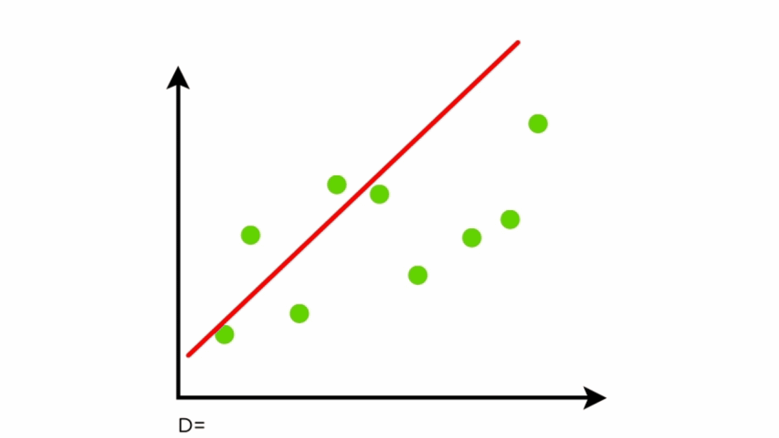
Finding the Best Fit Line
We keep moving this line through the data points to make sure the best fit line has the least square distance between the data points and the regression line

Slide 41
Finding the Best Fit Line
There are a lot of ways to minimize the distance between the line and the data points like Sum of Squared Errors, Sum of Absolute Errors, Root Mean Square Error etc.

Slide 42
Classification vs Regression
What is Linear Regression?
Types of Linear Regression
Understanding Simple Linear Regression

Slide 43
References
https://www.simplilearn.com/tutorials/machine-learning-tutorial/linear-regression-in-python

